Slide 1
A Review of Nonconformity Measures for Conformal Prediction in Regression
COPA 2023
Yuko Kato¹, David M.J. Tax¹ and Marco Loog²
1 Delft University of Technology, Delft, The Netherlands
2 Radboud University, Nijmegen, The Netherlands

Slide 2
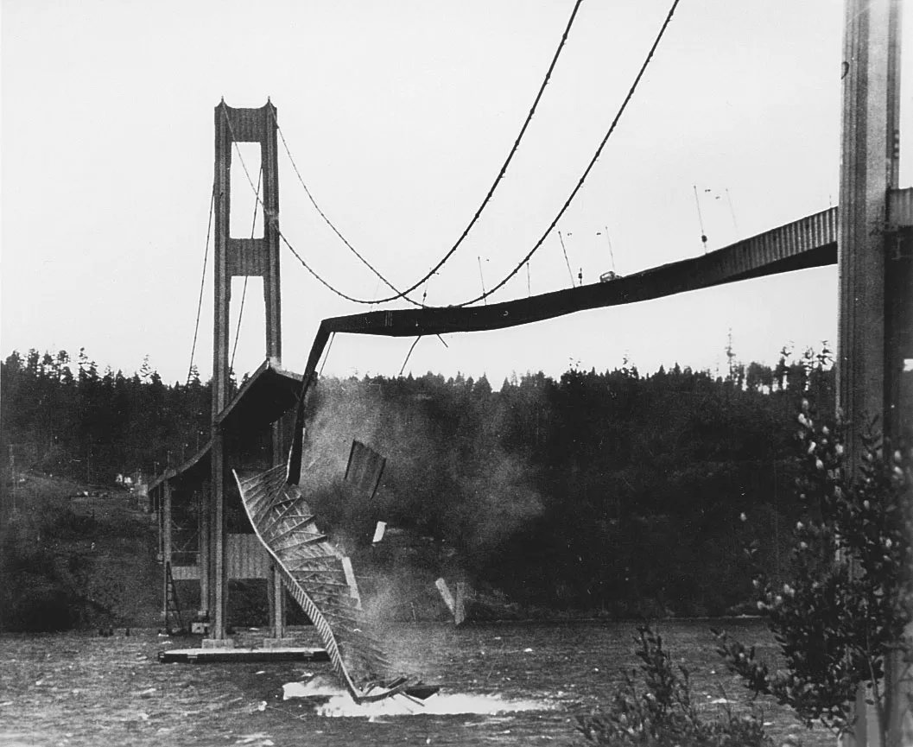
Rational
Uncertainty quantification (UQ): Estimating and quantifying uncertainty of models to assess the quality of the predictions
Popular approach: Bayesian Neural Network (however, requires prior distribution)
The question arises whether the estimated uncertainty is reliable or not (depending on the quality of prior distribution)
Conformal prediction provides distribution-free UQ under minimal assumptions (data are exchangeable)
https://www.britannica.com/topic/Tacoma-Narrows-Bridge

Slide 3
Conformal prediction (CP) in a regression setting
Validity
Prediction interval covers the true response with a pre-specified probability
Efficiency
The average length of the prediction intervals
Aim: Retain validity and maximize efficiency
NCM = Nonconformity measure

Slide 4
Motivation
An important aspect of CP is nonconformity measure (NCM)
The usefulness of the predictive confidence highly depends on the choice of the NCM (Angelopoulos and Bates, 2021; Papadopoulos, 2008)
Some variants of NCM have been developed, however the same NCM tends to be chosen in papers
In this paper…
analyze existing NCM (“absolute-error based” and “quantile-based”)
by assessing how they work, motivation to use them and possible advantages/ issues
Notes:
Important for practionors – real-world examples

Slide 5
Absolute error-based NCM #1
The absolute value of the difference between the prediction ${\hat{y}}_{i}$for $x_{i}$ and $y_{i}$
$$α_{i}=\left|y_{i}−{\hat{y}}_{i}\right|$$
Advantages
Straight-forward to use in regression setting
Note:
The same length of prediction intervals for all test examples potentially reduces the efficiency of conformal prediction (based on context, this could be problematic)

Slide 6
Absolute error-based NCM #2
Locally weighted NCM (Papadopoulos et al., 2002)
$$α_{i}=\left|\frac{y_{i}−{\hat{y}}_{i}}{σ_{i}}\right|$$
where
$$σ_{i}=e^{μ_{i}}, { μ}_{i}$$
is the prediction of the value
$$ln⁡(\left|y_{i}−{\hat{y}}_{i}\right|)$$
Advantages:
Length of prediction intervals will be proportional to the predicted accuracy of the underlying method at the new example
Note:
The underlying model is retrained on the pairs $(x_{i} ,\ln\left(\left|y_{i} − {\hat{y}}_{i}\right|\right))$ , these models do not necessarily have to be the same
This results in additional variability in NCM, thus this measure may not be well suited for TCP
Notes:
Possibility/ TCP

Slide 7
Absolute error-based NCM #3
Locally weighted NCM with hyperparameter(s) (Papadopoulos et al., 2007):
$$α_{i}=\left|\frac{y_{i}−{\hat{y}}_{i}}{σ_{i}+β}\right|$$
Possible to apply to different machine learning methods
→ More parameters
where
$$σ_{i}=e^{μ_{i}}$$
is the prediction of the value
$$ln⁡(\left|y_{i}−{\hat{y}}_{i}\right|)$$
Advantages:
The tighter prediction intervals can be obtained by adjusting β for each dataset (Papadopoulos and Haralambous, 2011)
All reasonable small values produce conformal predictors with similar efficiency (Johansson et al.,2014)
Note:
Not widely adopted even though it might be helpful to increase efficiency
Extending NCM not straightforward in some application settings (needs more research)
No papers found with extensive hyperparameter tuning
Notes:
By increasing $β$, we reduce the importance of $σ_{i}$ and as a result, increases the importance of all other examples
Remarks/ Note

Slide 8
Remarks for NCM #2 and #3
Used in several applications (e.g., Jablonka et al. (2020), Eklund et al. (2015))
Difficult to assess added value on application side as no reports were found directly comparing NCM#2 and NCM#3
Locally weighted NCMs generate inefficient prediction intervals when the data is homoscedastic (Lei et al., 2018)
The performance of these NCMs under different conditions (e.g. non-Gaussian distributions, different data sizes)
Knowledge obtained from such experiments can be used to determine whether locally weighted NCMs result in more efficient prediction intervals (focus of upcoming research)

Slide 9
Quantile-based NCM #4
Quantile-based NCM, focuses on estimating lower and upper conditional quantiles (Conformalized quantile regression) (Romano et al., 2019)
$$α_{i}=\max\left\{{\hat{q}}_{ε_{low}}\left(x_{i}\right)−y_{i}, y_{i}−{\hat{q}}_{ε_{high}}\left(x_{i}\right)\right\}$$
Advantage:
Fully adaptive to heteroscedastic data
Theoretically guarantees a valid coverage
Experiments show more efficient prediction intervals compared to NCM#2 and #3
Note:
In order to show that this method also works sufficiently efficient in the case of homoscedastic noise, further comparative research is needed
Notes:
Real-world example
Current research on bridge weight limitation is based on analysis using the reliability theory (James et al. 1986; Ghosn 2000; Kim 2012), which takes into consideration the uncertainties of the bridge resistance and vehicle load effects.
file:///C:/Users/yukok/Downloads/22.State-of-the-ArtReviewontheCausesandMechanismsofBridgeCollapse.pdf
For the safety purpose, it is important to have UQ

Slide 10
Challenges when choosing NCM
Efficiency:
No clear indication how normalized NCM (#2 and #3) choice influences efficiency (even though studies do show improved efficiency)
Therefore, at this moment, it is difficult to conclude which NCMs shows improved efficiency of the prediction intervals under specific conditions
Validity:
Although guaranteed validity using normalized NCMs (#2 and #3) and quantile-based NCM (#4) is shown empirically, a more detailed theoretical understanding is required.
In particular, specific knowledge on NCM performance, in case when parameters are to be extensively tuned on the training data, is currently lacking
Notes:
Overfitting

Slide 11
Challenges when choosing NCM cont’d
For normalized NCMs (#2 and #3), increasing the number of parameters may result in increased interval variability (impacting validity).
Trade-off between validity and efficiency with respect to the additional parameters
Furthermore, it is interesting to investigate whether it is possible to draw a parallel between validity-efficiency trade-off and the well-known bias-variance trade-off
Notes:
More params -> quick overfitting, CP still can give guarantee with overfitting,

Slide 12
Factors influencing the choice for NCM
Domain knowledge
Data size, noise type
Conformal prediction
How to split data
Underlying algorithm
Choosing NCM (Model agnostic/ dependent)
Optimal NCM dependent on the context
The choice of NCM – or development of a new NCM for that matter – has to be done mainly based on data
Utilizing information from domain knowledge or previous experiments

Slide 13
Conclusion
Promising results obtained in literature using CP
Several NCMs show good performance, although some aspects require more in-depth assessment of the advantages and disadvantages
We believe that this is an important step towards a broader adoption of CP across different fields
It is time to shift our attention to NCM more, particularly the development and study of NCMs under different circumstances
https://www.npr.org/sections/thesalt/2017/01/30/511204977/a-sip-of-history-the-hidden-wine-cellars-under-the-brooklyn-bridge

Slide 14
Thank you!

